Slide 1
COL874: Advanced Compiler Techniques Modules 181-185
Indrajit Banerjee

Slide 2
So far…
Today’s discussion…
Hoare triple notation
Assertions and Invariants
Verification conditions
Verification conditions for sequence operator
Verification conditions for if-then-else operator
Transfer function graph (TFG) representation
Sequencing with if-then-else operator
The ternary operator
Exponential paths problem
Verification conditions for loops
Floyd-Naur Proof method
Hoare logic

Slide 3
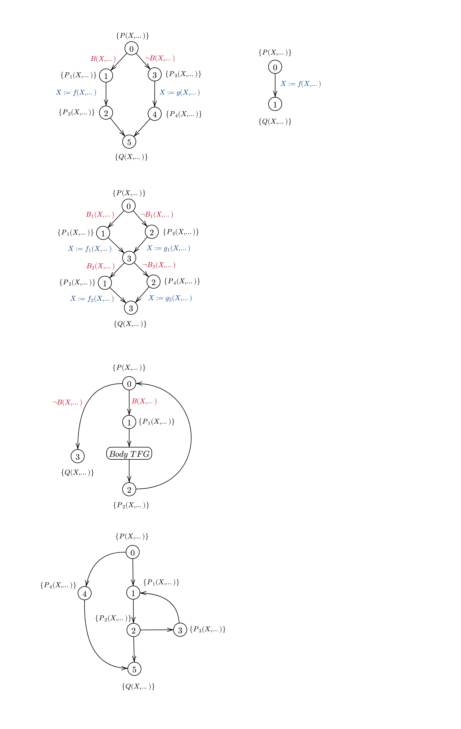
Transfer function graph (TFG) representation
A graphical representation of a program.
Each vertex represents a program point. This is where we want to prove assertions.
Each edge represents a transfer function (e.g., skip, assignment) and a condition under which the edge is taken.
{ P(X,…) }
X := f(X,…)
{ Q(X,…) }

Slide 4
Sequencing with if-then-else operator
{ P(X,…) }
if B(X,…) then
{ P1(X,…) }
X := f(X,…)
{ P2(X,…) }
else
{ P3(X,…) }
X := g(X,…)
{ P4(X,…) }
endif
{ Q(X,…) }

Slide 5
Sequencing with if-then-else operator
{ P ∧ B } skip { P₁ }
{ P ∧ ¬B } skip { P₃ }
{ P₁ } X := f(X,…) { P₂ }
{ P₃ } X := g(X,…) { P₄ }
{ P₂ } skip { Q }
{ P₄ } skip { Q }

Slide 6
Sequencing with if-then-else operator
{ P ∧ B } skip { P₁ }
{ P ∧ ¬B } skip { P₃ }
{ P₁ } X := f(X,…) { P₂ }
{ P₃ } X := g(X,…) { P₄ }
{ P₂ } skip { Q }
{ P₄ } skip { Q }
(P ∧ B) => P₁
(P ∧ ¬B) => P₃
P₁ => P₂ [X := f(X,…)]
P₃ => P₄ [X := g(X,…)]
P₂ => Q
P₄ => Q
Choose P₁,P₂,P₃,P₄ as follows…
P₂ = P₄ = Q
P₁ = P₂ [X := f(X,…)]
P₃ = P₄ [X := g(X,…)],
Verification conditions simplify to,
(P ∧ B) => Q [X := f(X,…)]
(P ∧ ¬B) => Q [X := g(X,…)],
Define (C ? A : B) ⬄ (C => A) ∧ (¬C => B) further simplifying the verification conditions to,
P => (B ? Q [X := f(X,…) : Q [X := g(X,…)]

Slide 7
Sequencing with if-then-else operator
Define the ternary operator (B ? e1 : e2) such that programs C₁ and C₂ are equivalent
Program C₁
if B then
X := e1
else
X := e2
endif
Program C₂
X := B ? e1 : e2
From if-then-else rule,
{ P } C₁ { Q } ⬄ P => (B ? Q[X := e1] : Q[X := e2])
From assignment rule,
{ P } C₂ { Q } ⬄ P => Q[X := B ? e1 : e2]
By definition, C₁ ⬄ C₂
Hence,
P => (B ? Q[X := e1] : Q[X := e2]) ⬄ P => Q[X := B ? e1 : e2]
B ? Q[X := e1] : Q[X := e2] ⬄ Q[X := B ? e1 : e2]

Slide 8
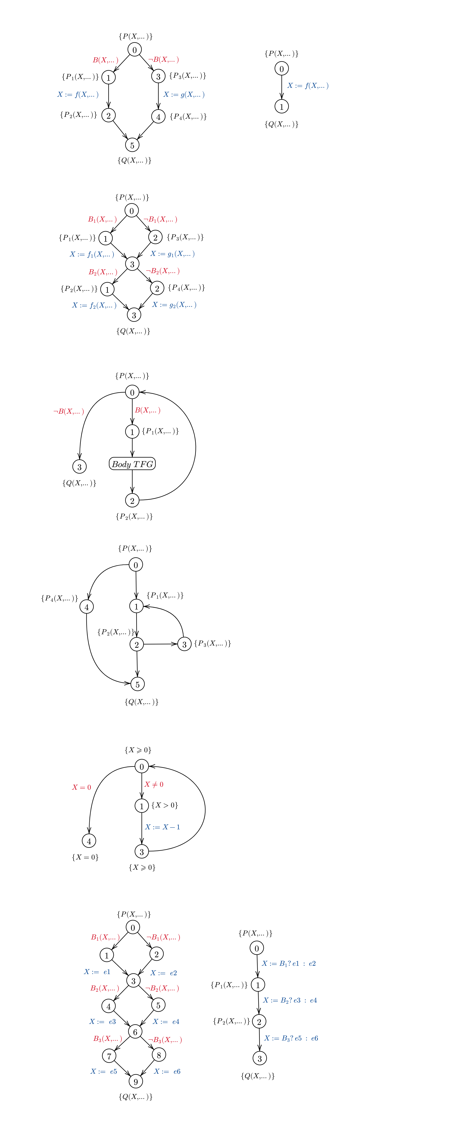
Exponential paths problem
{ P }
X := B₁ ? e1 : e2
{ P₁ }
X := B₂ ? e3 : e4
{ P₂ }
X := B₃ ? e5 : e6
{ Q }

Slide 9
Exponential paths problem
Combining verification conditions of assignment and sequencing,
P => P₁[X := B₁?e1:e2]
P₁ => P₂[X := B₂?e3:e4]
P₂ => P₃[X := B₃?e5:e6]
Choose P₁,P₂ as follows…
P₁ = P₂[X := B₂?e3:e4]
P₂ = P₃[X := B₃?e5:e6]
Verification condition simplifies to,
P => P₁[X := B₃?e5:e6] [X := B₂?e3:e4] [X := B₁?e1:e2]
Note: B_{i}’s and ei’s are also functions of X in general.
Size of the expression grows exponentially!

Slide 10
Verification conditions for loops
{ P(X,…) }
while B(X,…) {
{ P1(X,…) }
Body
{ P2(X,…) }
}
{ Q(X,…) }
Hoare triple queries:
{ P ∧ B } skip { P₁ }
{ P ∧ ¬B } skip { Q }
{ P₁ } Body { P₂ }
{ P₂ } skip { P }
Verification conditions:
(P ∧ B) => P₁
(P ∧ ¬B) => Q
Induction on Body
P₂ => P

Slide 11
Floyd-Naur Proof method
Proof of partial-correctness only. Does not prove termination!
Represent the program as a transfer function graph
Find assertion Pi at vertex i for all intermediate vertices of the graph
Construct a Hoare triple query { Pi ∧ B } f { Pj } for each edge (i, j) of the graph
Prove the verification condition corresponding to each query
Example TFG

Slide 12
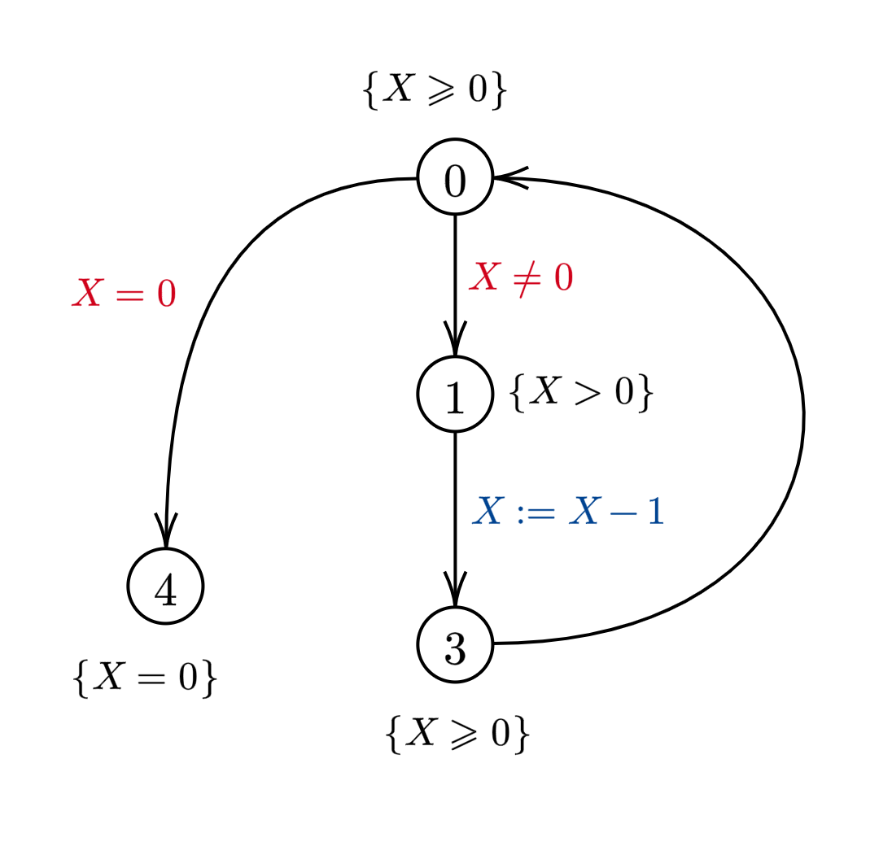
Floyd-Naur Proof method example
{ X ≥ 0 }
while X ≠ 0 {
{ X > 0 }
X := X - 1
{ X ≥ 0 }
}
{ X = 0 }
Hoare triple queries:
{ X ≥ 0 ∧ X ≠ 0 } skip { X > 0 }
{ X ≥ 0 ∧ X = 0 } skip { X = 0 }
{ X > 0 } X := X - 1 { X ≥ 0 }
{ X ≥ 0 } skip { X ≥ 0 }
Verification conditions:
(X ≥ 0 ∧ X ≠ 0) => X > 0 ⬄ true
(X ≥ 0 ∧ X = 0) => X = 0 ⬄ true
X > 0 => { X - 1 ≥ 0 } ⬄ true
X ≥ 0 => X ≥ 0 ⬄ true

Slide 13
Hoare logic
Previous approach…
Hoare logic formulation…
Given a Hoare triple query
Lower it to a first order logic formula (verification conditions)
Prove the first order logic formula
Form an inference rule
Abstract it using Hoare triples
Given a first order logic formula which is always true i.e., a tautology

Slide 14
Hoare logic rules
Assignment
{ P } x := e { Q } ⬄ P => Q [x := e]
We know that P => P is a tautology.
Substituting Q [x := e] for P,
{ Q [x := e] } x := e { Q } ⬄
Q [x := e] => Q [x := e] ⬄ true
{ P [x := e] } x := e { P }
Composition
{ P } C₁ { R } { R } C₂ { Q }
{ P } C₁;C₂ { Q }
If-then-else
{ P ∧ B } C₁ { Q } { P ∧ ¬B } C₂ { Q }
{ P } if B then C₁ else C₂ endif { Q }
Consequence
P => P’ { P’ } C { Q’ } Q’ => Q
{ P } C { Q }
(2)
(3)
(1)
(4)

Slide 15
Hoare logic example
true true true
(x = x₀ ∧ x > 0) => x = |x₀| (x = x₀ ∧ x ≤ 0) => (-x = |x₀|) { -x = |x₀| } x := -x { x = |x₀| } (x = |x₀|) => (x = |x₀|)
{ x = x₀ ∧ x > 0 } skip { x = |x₀| } { x = x₀ ∧ x ≤ 0 } x := -x { x = |x₀| }
{ x = x₀ } if x > 0 skip else x := -x endif { x = |x₀| }
{ x = x₀ }
if x > 0
skip
else
x := -x
endif
{ x = |x₀| }
Apply Hoare logic rules backward starting from the required Hoare triple until all branches end in valid axiom (skip and assignment).
Composition & consequence rules contain variables in premise that do not occur in conclusion.
Skip and Consequence rule requires first order logic proof obligations.
(1)
(4)
(3)

Slide 16
Thank You

